Slide 1
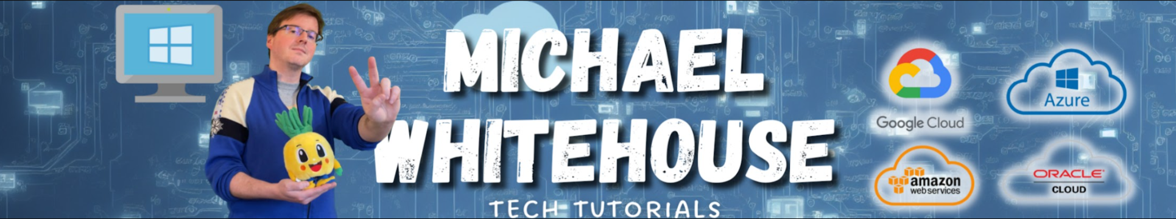
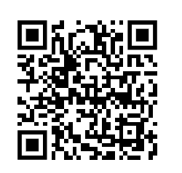
Youtube.com/@mwcloud github.com/kramit mike@michaelwhitehouse.com
AZ-104 Azure Administrator

